Slide 1
22CS017
Object Oriented Software Engineering
Dr Anuj Jain
Associate Professor
Department of Computer Science and Engineering
Chitkara University, Punjab

Slide 2
UNIT-I
Topics for Software Engineering-Agile
Agile View of Process: what is agility
What is an Agile process
Agile Process Models: extreme programming (XP)
ASD-Adaptive Software Development
Scrum

Slide 3
What is “Agility”?!
■ Effective (rapid and adaptive) response to change!
■ Effective communication among all stakeholders!
■ Drawing the customer onto the team!
■ Organizing a team so that it is in control of the work performed!
Yielding …!
■ Rapid, incremental delivery of software
The meaning of Agile is swift or versatile. "Agile process model" refers to a software development approach based on iterative development. Agile methods break tasks into smaller iterations, or parts do not directly involve long term planning. The project scope and requirements are laid down at the beginning of the development process. Plans regarding the number of iterations, the duration and the scope of each iteration are clearly defined in advance.

Slide 4
Agility and the Cost of Change

Slide 5
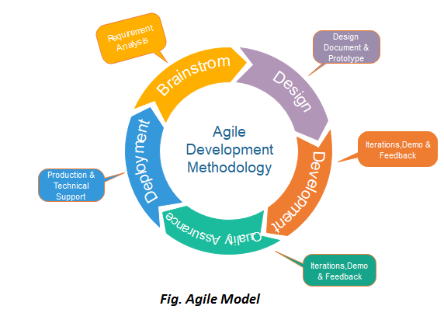
An Agile Process!
■ Is driven by customer descriptions of what is required (scenarios)!
■ Recognizes that plans are short-lived!
■ Develops software iteratively with a heavy emphasis on construction activities!
■ Delivers multiple ʻsoftware incrementsʼ!
■ Adapts as changes occur!

Slide 6
The Phases in the Agile model
Following are the phases in the Agile model are as follows:
Requirements gathering, Design the requirements, Construction/ iteration, Testing/ Quality assurance, Deployment, Feedback
Human Factors!
the process molds to the needs of the people and team, not the other way around!
Key traits must exist among the people on an agile team &team itself
■ Competence.!
■ Common focus.!
■ Collaboration.!
■ Decision-making ability.!
■ Fuzzy problem-solving ability.!
■ Mutual trust and respect.!
■ Self-organization.!

Slide 7
12 Principles of Agile
Customer satisfaction
Early and continuous delivery
Embrace change
Frequent delivery
Collaboration of businesses and developers
Motivated individuals
Face-to-face conversation
Functional products
Technical excellence
Simplicity
Self-organized teams
Regulation, reflection and adjustment

Slide 8
Examples of Agile Methodology
Agile Scrum Methodology.
Lean Software Development.
Kanban.
Extreme Programming (XP)
Crystal.
Dynamic Systems Development Method (DSDM)
Feature Driven Development (FDD)

Slide 9
Advantage of Agile Method
When to use the Agile Model?
When frequent changes are required.
When a highly qualified and experienced team is available.
When a customer is ready to have a meeting with a software team all the time.
When project size is small.
Advantage(Pros) of Agile Method:
Frequent Delivery
Face-to-Face Communication with clients.
Efficient design and fulfils the business requirement.
Anytime changes are acceptable.
It reduces total development time.

Slide 10
Extreme Programming (XP)
This type of methodology is used when customers are constantly changing demands or requirements, or when they are not sure about the system's performance.
■
The most widely used agile process, originally proposed by Kent Beck!
■ XP Planning!
■ Begins with the creation of “user stories”!
■ Agile team assesses each story and assigns a cost!
■ Stories are grouped to for a deliverable increment!
■ A commitment is made on delivery date!
■ After the first increment “project velocity” is used to help define subsequent delivery dates for other increments!

Slide 11
XP Design! Coding! Testing!
■ XP Design!
■ Follows the KIS principle!
■ Encourage the use of CRC cards
■ For difficult design problems, suggests the creation of “spike solutions”—a design prototype!
■ Encourages “refactoring”—an iterative refinement of the internal
program design!
■ XP Coding!
■ Recommends the construction of a unit test for a store before
coding commences!
■ Encourages “pair programming”!
■ XP Testing!
■ All unit tests are executed daily!
■ “Acceptance tests” are defined by the customer and excuted to assess customer visible functionality!

Slide 12
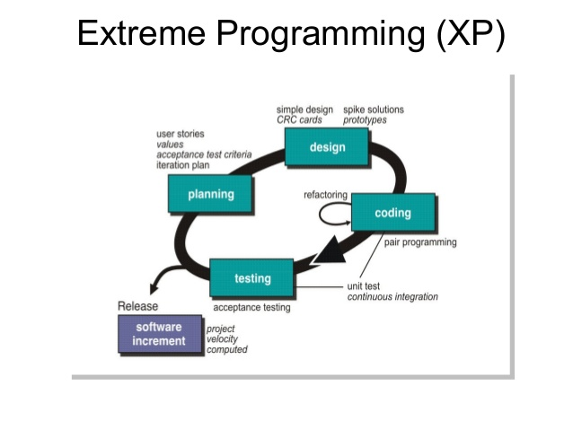
XP

Slide 13
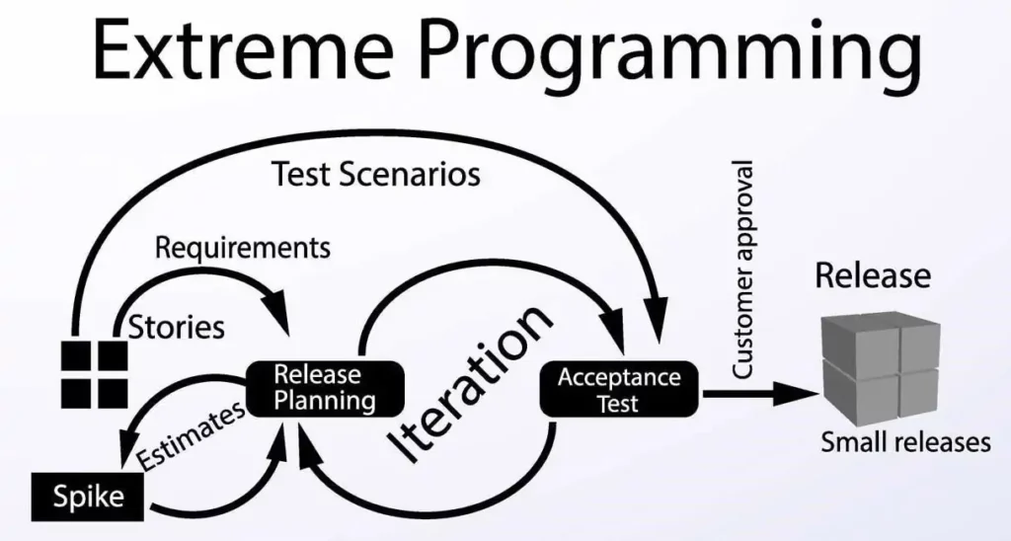
eXtreme Programming(XP)

Slide 14
Adaptive Software Development
Adaptive Software Development
■ Originally proposed by Jim Highsmith!
■ ASD — distinguishing features!
■ Mission-driven planning!
■ Component-based focus!
■ Uses “time-boxing”
■ Explicit consideration of risks!
■ Emphasizes collaboration for requirements gathering!
■ Emphasizes “learning” throughout the process!

Slide 15
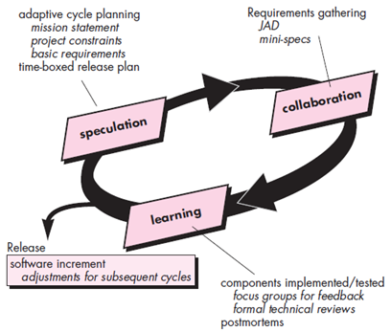
■ ASD

Slide 16
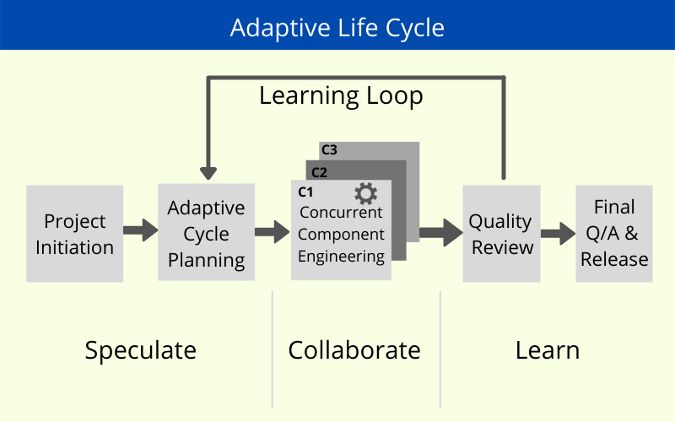
Adaptive Life Cycle

Slide 17
SCRUM
Originally proposed by Schwaber and Beedle!
■ Scrum—distinguishing features!
■ Development work is partitioned into “packets”!
■ Testing and documentation are on-going as the product is constructed!
■ Work occurs in “sprints” and is derived from a “backlog” of existing requirements!
■ Meetings are very short and sometimes conductedwithout chairs!
■ “demos” are delivered to the customer with the timebox allocated!

Slide 18
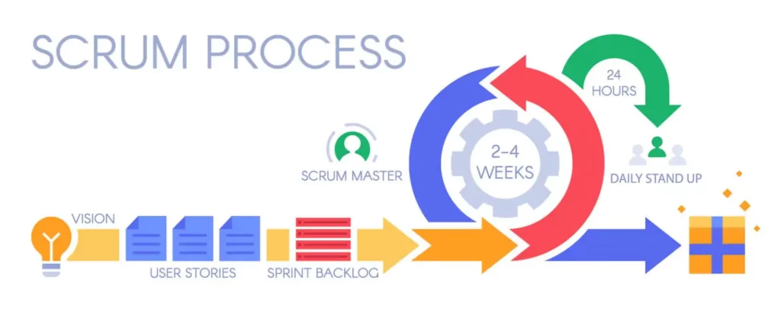
SCRUM PROCESS
Scrum is a framework for helping teams develop complex projects in an adaptive manner. Scrum doesn’t dictate how developers do the work. XP, as mentioned, puts much emphasis on good programming practices.

Slide 19
XP vs Scrum
Also, XP is obviously about programming. Scrum, on the other hand, can be applied to any project that benefits from an iterative approach. XP accepts changes to its components. Teams are allowed and even encouraged to tweak the practices according to their specific needs.
The Scrum Guide, on the other hand, is adamant in stating that “While implementing only parts of Scrum is possible, the result is not Scrum.” Also, Scrum is a framework that you need to fill out with methodologies and practices for doing the work. That means that it’s not only possible to use XP and Scrum together but extremely recommended.

Slide 20
Scrum: Three roles
There are three roles in it, and their responsibilities are:
Scrum Master: The scrum can set up the master team, arrange the meeting and remove obstacles for the process
Product owner: The product owner makes the product backlog, prioritizes the delay and is responsible for the distribution of functionality on each repetition.
Scrum Team: The team manages its work and organizes the work to complete the sprint or cycle.
Product backlog: The product backlog is a prioritized features list containing every desired feature or change to the product. Note: The term “backlog” can get confusing because it’s used for two different things. To clarify, the product backlog is a list of desired features for the product. The sprint backlog is a list of tasks to be completed in a sprint.

Slide 21
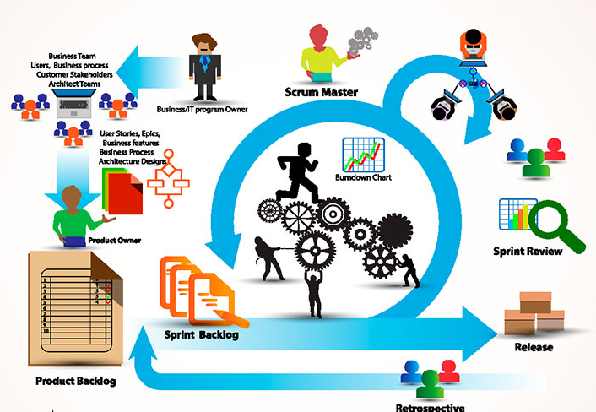
Three roles -SCRUM

Slide 22
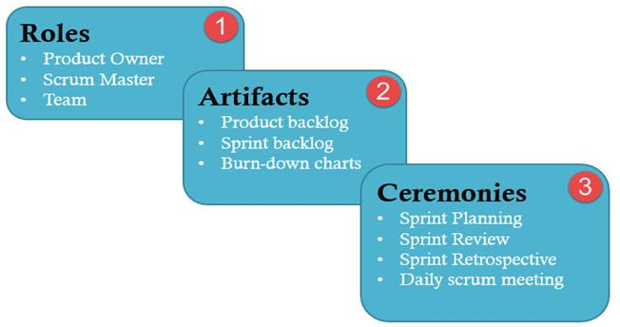
Key Features of Scrum Methodology
Scrum has a short fixed schedule of release cycles with adjustable scope known as sprints to address rapidly changing development needs. Each release could have multiple sprints. Each Scrum Project could have multiple Release Cycles.
A repeating sequence of meetings, events, and milestones
A practice of testing and implementing new requirements, known as stories, to make sure some work is released ready after each sprint

Slide 23
SCRUM
Sprint planning meeting: At the start of each sprint, a sprint planning meeting is held, during which the product owner presents the top items on the product backlog to the team. The Scrum team selects the work they can complete during the coming sprint. That work is then moved from the product backlog to a sprint backlog, which is the list of tasks needed to complete the product backlog items the team has committed to complete in the sprint.
Daily Scrum: Each day during the sprint, a brief meeting called the daily scrum is conducted. This meeting helps set the context for each day’s work and helps the team stay on track. All team members are required to attend the daily scrum.
Sprint review meeting: At the end of each sprint, the team demonstrates the completed functionality at a sprint review meeting, during which, the team shows what they accomplished during the sprint. Typically, this takes the form of a demonstration of the new features, but in an informal way; for example, PowerPoint slides are not allowed.
Sprint retrospective: Also at the end of each sprint, the team conducts a sprint retrospective, which is a meeting during which the team (including its Scrum Master and product owner) reflect on how well Scrum is working for them and what changes they may wish to make for it to work even better.

